Slide 1
Chapter 12: Adaptive responses

Slide 2
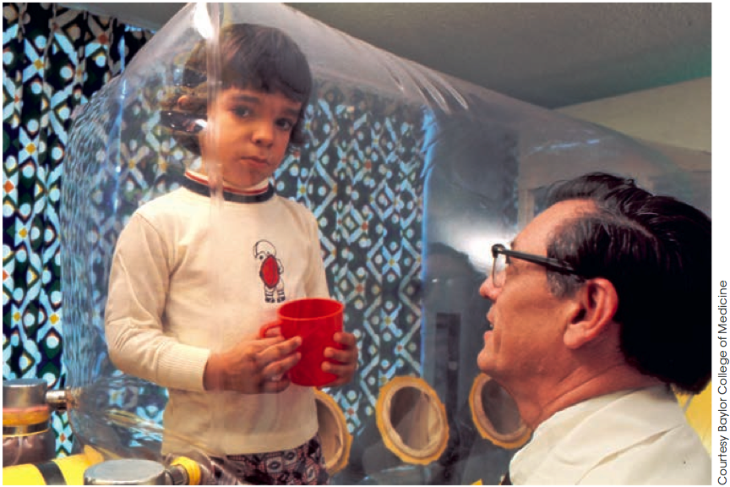
Immunity with memory
Adaptive immunity
David Vetter was born in 1971 without an adaptive immune system, in a condition known as severe combined immunodeficiency (SCID).
David was raised from birth in a sterile isolator unit designed by NASA to keep all pathogens out.
Figure 12.1
This highlights the critical importance of adaptive immunity in allowing us to survive attacks from potential pathogens.

Slide 3
Immunity with memory
Adaptive immunity
The adaptive immune response differs from the innate response because it:
has specific recognition of antigens
displays memory.
Memory is the reason why people who get chicken pox as a child do not catch the disease.
It is also the scientific basis for immunisation.

Slide 4
Immunity with memory
Lymphocytes
The key players in adaptive immunity are a type of leukocytes (white blood cells) called lymphocytes. These include:
B lymphocytes (B cells) Produce proteins called antibodies that
bind to pathogens to neutralise them and
tag them for phagocytosis
T lymphocytes (T cells) Include cytotoxic T (T_{c}) cells (also called
killer T cells) which kill virally infected and
cancerous cells, helper T (T_{H}) cells, which
help other lymphocytes in their roles and
regulatory T (T_{reg}) cells, which control the
magnitude and duration of responses.

Slide 5
Immunity with memory
Self and non-self
Like in innate immune responses, it is essential to be able to tell friend from foe.
Normal body cells express proteins that identify them as ‘self’. These proteins are the major histocompatibility complex (MHC).
The MHC of an individual differs from that of other individuals because it is determined by their genotype.
Other MHC markers or an absence of MHC markers identifies a cell as foreign, or ‘non-self’.
This is the basis of transplant rejection.

Slide 6
Immunity with memory
Antigen receptors
Lymphocytes have surface receptors that allow them to recognise foreign antigens and recognise ‘self’ from ‘non-self’.
Cell | Antigen Receptor | Structure | Recognises
B cells | B cell receptor (BCR) | A membrane-bound antibody with constant and variable regions | Epitopes of foreign antigens
T cells | T cell receptor (TCR) | A heterodimer with constant and variable regions | Peptides of foreign antigens presented on MHC molecules
The concept that T cells only recognise peptides when in complex with MHC is called MHC restriction.

Slide 7
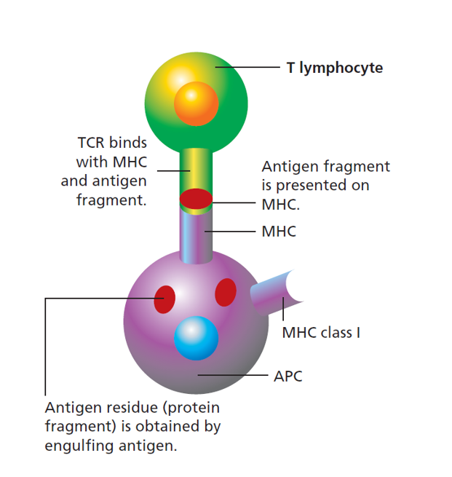
Immunity with memory
MHC
Figure 12.3

Slide 8
Immunity with memory
MHC
There are two types of MHC markers: MHC class I and MHC class II.
MHC | Displays | Expressed on | Recognised by
MHC class I | Peptides derived from internal antigens (e.g. cytoplasmic components) | All nucleated body cells (i.e. all cells but not red blood cells) | The TCR of cytotoxic T cells
MHC class II | Peptides derived from phagocytosed antigens | Professional antigen-presenting cells (APCs): B cells, macrophages and dendritic cells | The TCR of helper T cells

Slide 9
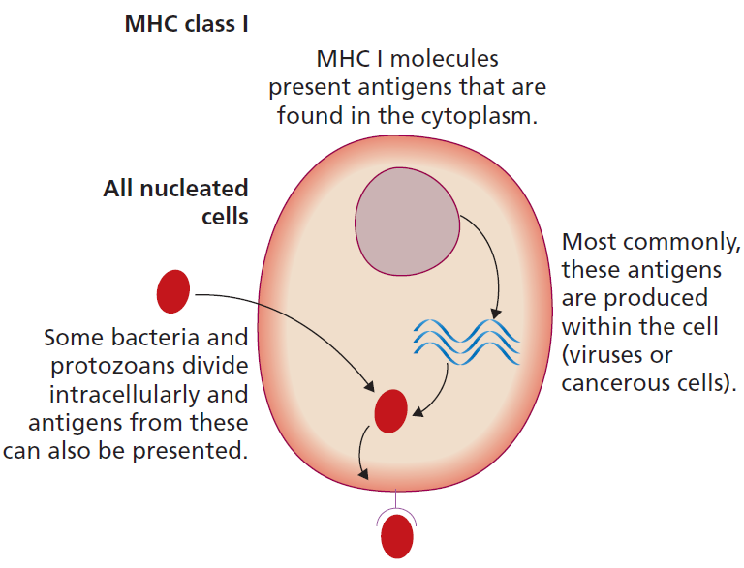
Immunity with memory
MHC class I
MHC class I molecules present a random selection of peptides derived from internal components of the cell.
These can be scanned by T_{c} cells to check for abnormalities such as viral infection or tumour transformation.
Figure 12.4

Slide 10
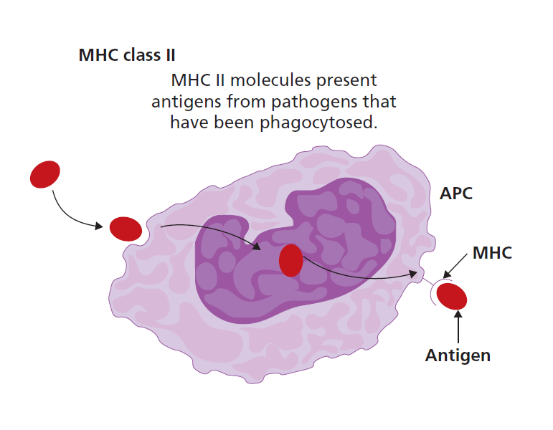
Immunity with memory
MHC class II
MHC class II molecules present peptides derived from antigens that have been endocytosed by phagocytosis or receptor-mediated endocytosis.
These are recognised by T_{H} cells and are only expressed by professional antigen-presenting cells: B cells, macrophages and dendritic cells.
Figure 12.4

Slide 11
Immunity with memory
Receptor diversity
Each B or T lymphocyte carries a large number of identical copies of an antigen receptor which can bind to a single, specific antigen.
There are so many different lymphocytes with different receptors that around 10 million different epitopes can be recognised by the entire population of lymphocytes.
The different specificities of antigen receptors arise by random genetic recombination of the genes that encode the variable regions of the antigen receptors (BCR/antibody or TCR).

Slide 12
Immunity with memory
Avoiding self-recognition
The random generation of receptors results by chance in some receptors that will bind to ‘self’ molecules.
B and T cell clones that recognise self molecules are deleted (by activation of apoptosis) or inactivated in a process of selection during their development.
The result is self-tolerance, meaning that ideally, there are no mature lymphocytes that react against self molecules.
Sometimes this process is not completely successful; this can result in autoimmune diseases.

Slide 13
Immunity with memory
Avoiding self-recognition
T_{c} cells and B cells require T_{H} cells for their activation. The T_{H} cells that help them must be activated by antigen-presenting cells.
Another means of avoiding self-recognition is the nature of the interaction between an APC and the T_{H} cell.
If the APC has recognised a PAMP or a DAMP, it will express co-stimulatory receptors that pass on the danger signal to the T_{H} cell.
T cells need two signals for activation:
Recognition of their specific peptide/MHC complex
Co-receptor stimulation by co-stimulatory receptors on APCs

Slide 14
Immunity with memory
Clonal selection
Activation of a lymphocyte by the necessary signals results in proliferation of the clone, making many copies of itself.
Cell | Activation signal 1 | Activation signal 2
B cell | Cross-linking of the BCR by its specific epitope | Cytokines or contact-dependent signalling from T_{H} cell
T_{H} cell | Recognition of its specific epitope in complex with MHC class II | Co-stimulatory receptors on APC surface binding to co-receptors on T_{H} cell
T_{c} cell | Recognition of its specific epitope in complex with MHC class I | Cytokines or contact-dependent signalling from T_{H} cell
Lymphocytes need both activation signals to become activated themselves.

Slide 15
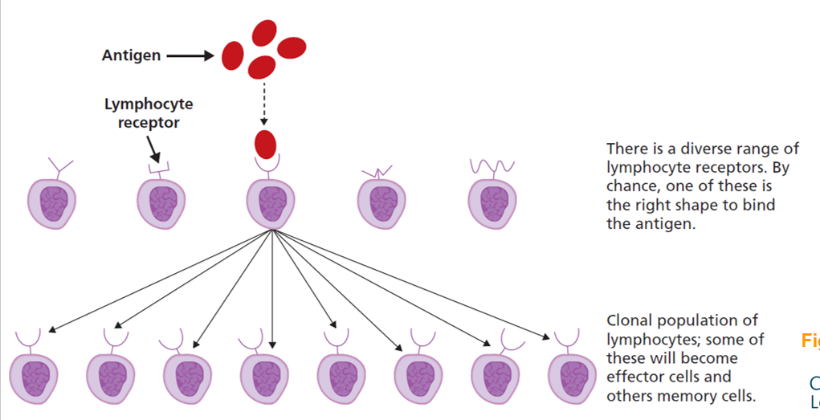
Immunity with memory
Clonal selection
Once a lymphocyte clone is activated, it undergoes massive proliferation, increasing the number of copies of the lymphocyte clone and thus its antigen receptor. This is clonal selection.
Australian Sir Macfarlane Burnet was awarded a Nobel Prize in the 1950s for his contribution to this theory.
Figure 12.6

Slide 16
Humoral immunity
Antibodies
The humoral immune response is brought about by B cells which produce antibodies.
Surface-bound antibodies act as the B cell receptor and, once a B cell is activated and undergoes clonal selection, it can begin secreting huge quantities of antibodies into the bloodstream.
Antibodies are highly stable and persist for around three weeks in circulation.

Slide 17
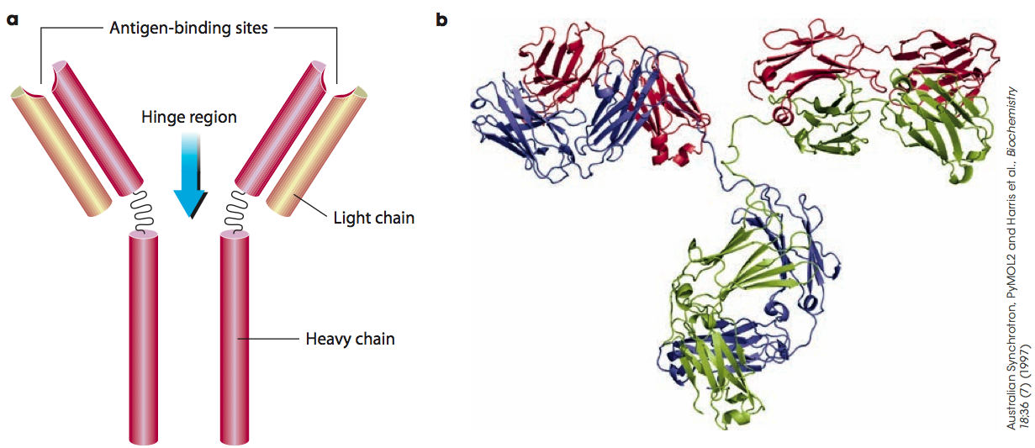
Humoral immunity
Antibodies
Antibodies (also called immunoglobulins) have a constant region and variable regions. The variable regions are the antigen-binding sites.
Variable regions
Constant region
Figure 12.7

Slide 18
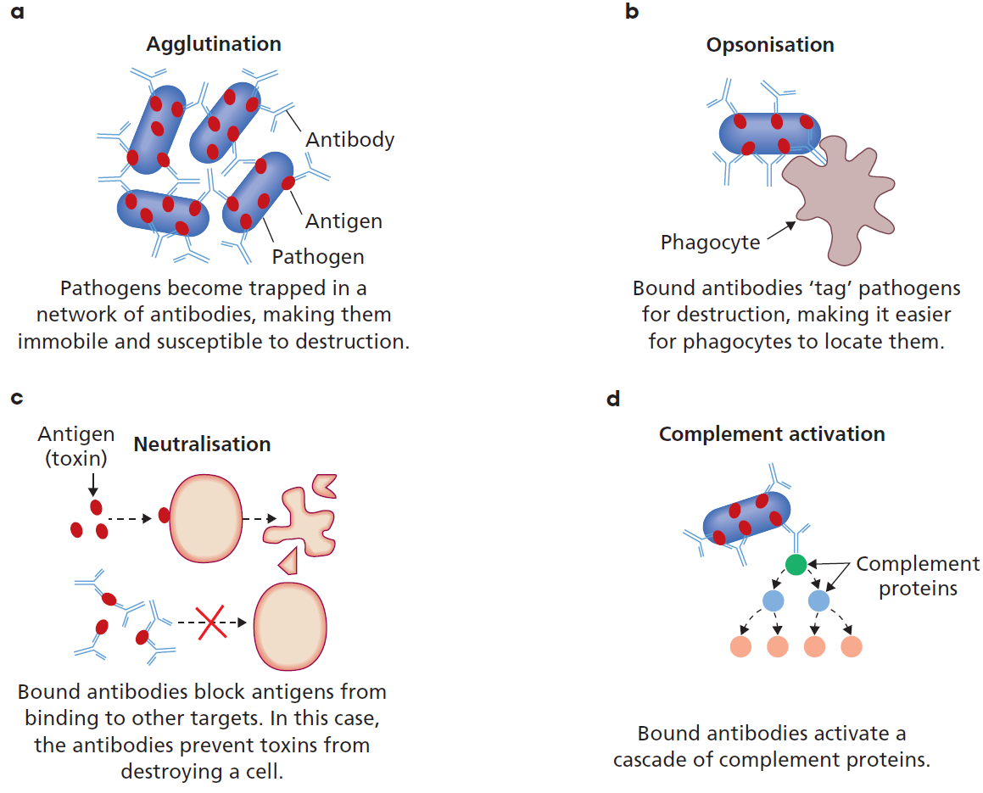
Humoral immunity
Antibodies
Antibodies have several functions:
Agglutination
Opsonisation
Neutralisaion
Complement activation
Figure 12.8

Slide 19
Humoral immunity
Antibodies
The constant regions of antibodies can belong to one of several classes, known as isotypes. Each isotype confers a different specialised function.
Isotype | Found | Function
IgM | As the BCR on all B cells before activation | Exist as a pentamer and are the first isotypes produced in a response
IgA | Particularly important in the gut and mucus membranes | Secreted over mucosal membranes, neutralises pathogens to keep numbers under control
IgG | Produced by matured B cells and present as the BCR on memory B cells | Complement activation, opsonisation, neutralisation of toxins. Passed over the placenta to the baby
IgE | Produced by matured B cells | Protection against parasites, responsible for allergic reactions
IgD | Co-expressed with IgM but not secreted into circulation | Has roles in B cell signal transduction

Slide 20
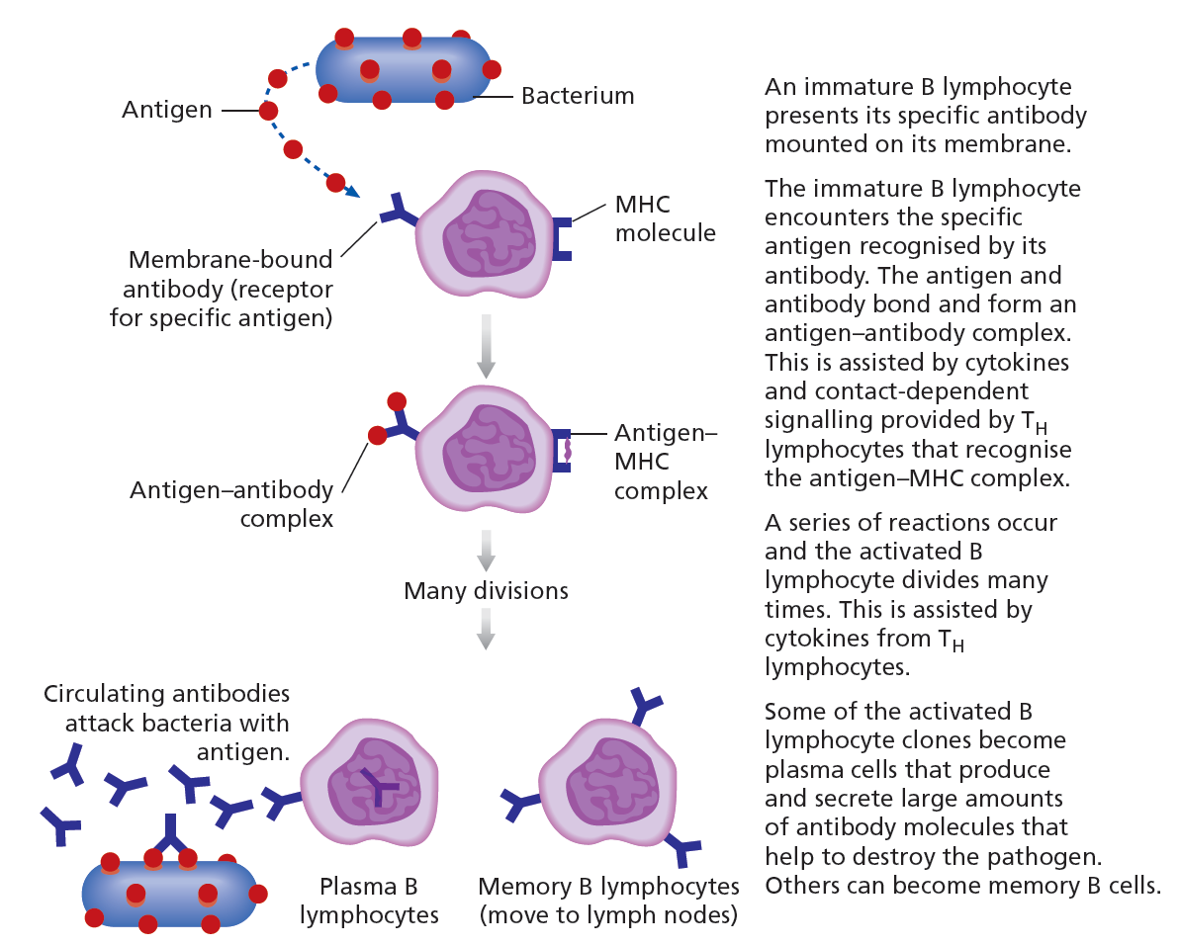
Humoral immunity
Antibodies
T_{h} cell help is needed to make this most efficient, in the form of cytokines or contact-dependent signalling, or both.
Figure 12.9

Slide 21
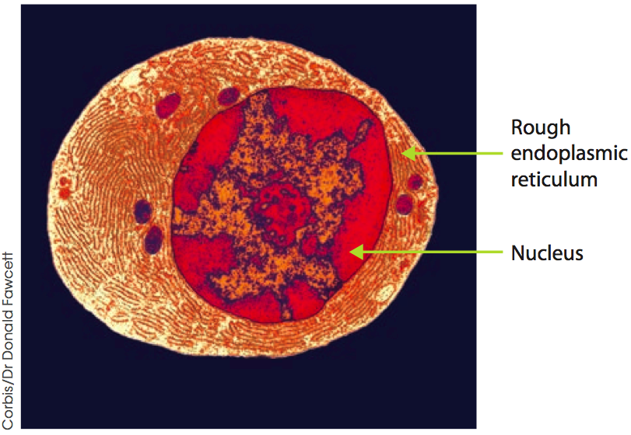
Humoral immunity
Plasma cells
Effector B cells are called plasma cells.
Plasma cells have differentiated to become highly specialised for antibody production.
They have high amounts of machinery in the secretory pathway, particularly rough endoplasmic reticulum.
Figure 12.10
Plasma cells can secrete up to 10 000 antibody molecules per second.
They can live in the bone marrow for years or even decades.

Slide 22
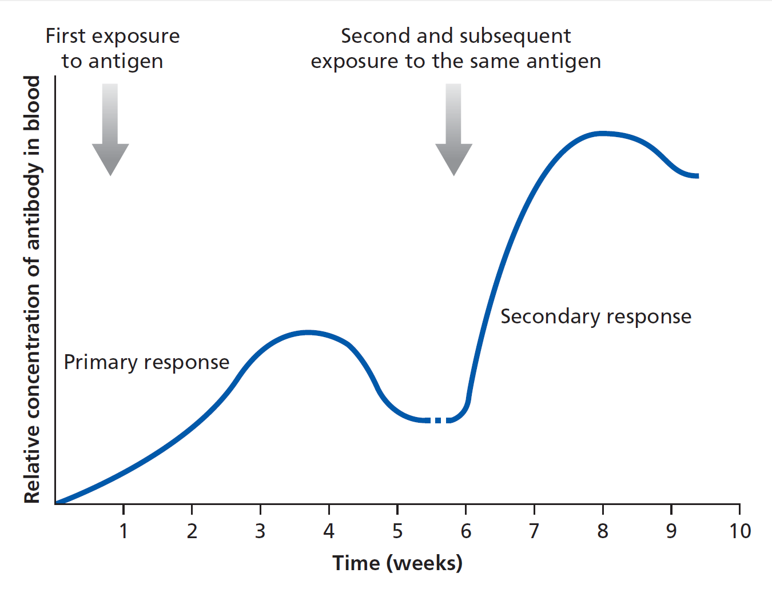
Humoral immunity
Memory B cells
Figure 12.11
During clonal expansion, plasma cells are formed, as well as memory B cells.
These cells can rapidly proliferate and produce plasma cells upon re-encounter with the specific antigen. This is the reason that antibody levels can be much higher and appear much more rapidly in the secondary response.

Slide 23
Humoral immunity
Vaccination
During a primary response, it takes time for an adaptive immune response to develop and mature. In a secondary response, memory B and T cells are ready to respond rapidly and with a high quality response.
Vaccination (immunisation) aims to replicate a primary response to generate immunological memory.
Vaccines usually comprise components of a pathogen or a whole, inactivated form of the pathogen, together with an adjuvant.
An adjuvant is a substance that provides PAMPs and/or DAMPs to provide the danger signals necessary to activate the innate (and therefore adaptive) response.

Slide 24
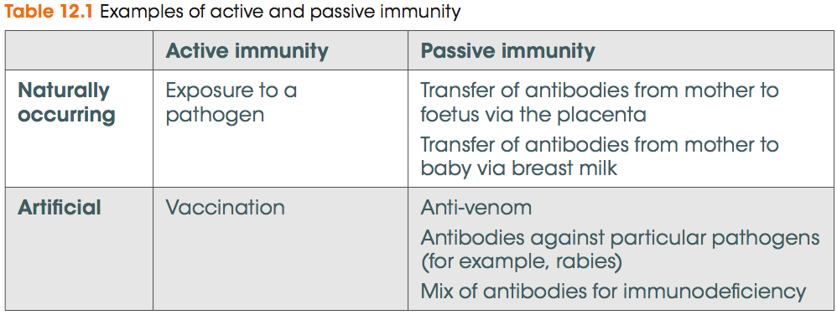
Humoral immunity
Active and passive immunity
Active immunity is generated when the immune system is stimulated to mount a response, such as by infection of immunisation.
Passive immunity is when antibodies are provided from an external source to provide protection.

Slide 25
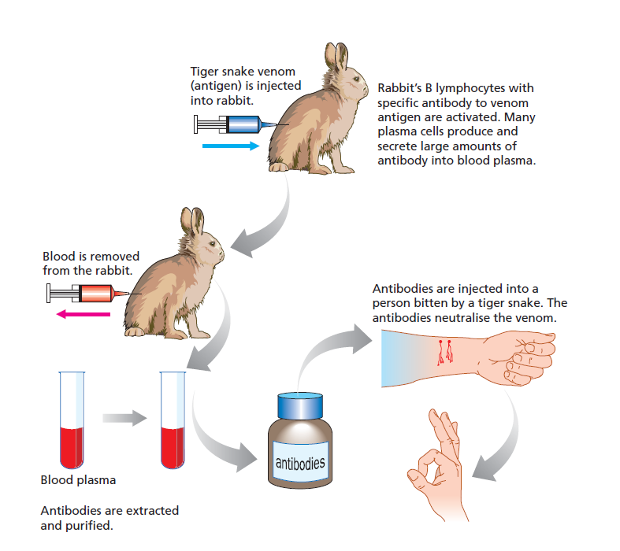
Humoral immunity
Antibodies and snakebite
Snakebites are treated with anti-venom, which is antibodies usually derived from rabbits that have been immunised with small amounts of snake venom proteins.
Figure 12.12

Slide 26
Humoral immunity
Applications of antibodies
The properties of antibodies make them extremely useful molecular tools:
Their variable region allows them to be used to recognise specific molecules
Their constant region can be labeled with a tag to allow isolation or identification.
Monoclonal antibodies can be produced in the lab by fusing a plasma cell with a tumour cell, creating a hybridoma, which is an immortalised plasma cell line.
Monoclonal antibodies are used widely, for example in pregnancy tests to detect the presence of a hormone, β-HCG, and as drugs to neutralise proteins such as cytokines.

Slide 27
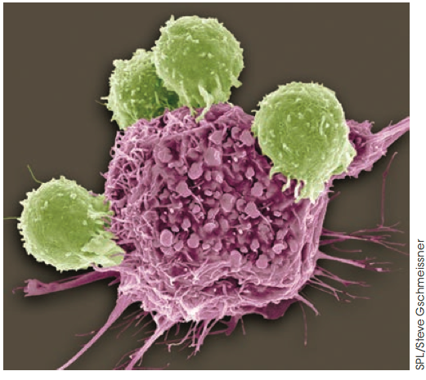
Cell-mediated immunity
T_{c} lymphocytes
Cell-mediated immunity involves the direct killing of virally infected and cancerous cells by T_{c} lymphocytes.
T_{c} cells recognise non-self cells (i.e. transplanted cells) because they express non-self MHC class I.
T_{c} cells recognise virally infected cells presented on MHC class I.
T_{c} cells recognise tumour cells by presentation of tumour antigens on MHC class I.
Figure 12.16.
A Tc cell attacking a cancer cell

Slide 28
Cell-mediated immunity
Natural killer cells
Some viruses have evolved mechanisms to hide from the immune system by down-regulating MHC class I.
Natural killer (NK) cells detect and kill cells that do not express MHC class I.

Slide 29
Cell-mediated immunity
T_{c} cell killing mechanisms
When activated by peptide/MHC class I plus T_{H} cell help, T_{c} cells divide many times to form an army of clones.
Some clones become memory T_{c} cells and others become effector T_{c} cells, with the capacity to kill target cells.
T_{c} cells can release contents of vesicles when in contact with target cells. The vesicles contain:
Perforin A protein that forms pores in the target cell membrane
Granzyme A protein that induces apoptosis in the target cell
T_{c} cells can also produce cytokines including interferons.

Slide 30
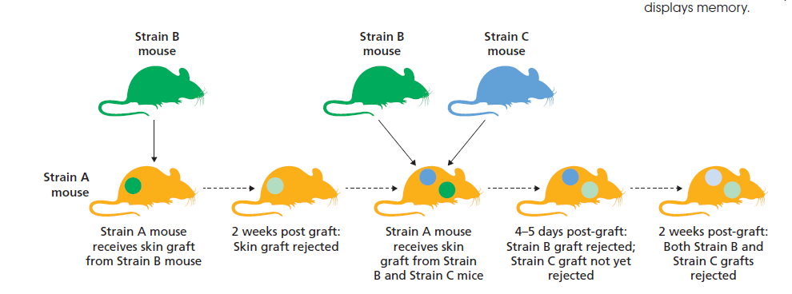
Cell-mediated immunity
T_{c} cell role in transplant rejection
The feature of memory in cell-mediated immunity is shown in this graft rejection experiment.
Figure 12.17

Slide 31
Cell-mediated immunity
T_{H} cells
T_{H} cells assist T_{c} cells and B cells by
secreting cytokines
contact-dependent signalling
Cytokines can also stimulate other immune cells, such as by enhancing the phagocytic activity of macrophages.
In HIV, T_{H} cells are infected and destroyed.
T_{reg} cells moderate immune responses by suppressing the activities of other immune cells including T_{c} cells, B cells and phagocytes.
These cells are essential for preventing autoimmunity.

Slide 32
Linking parts of the immune system
Connections between the innate and adaptive responses
Many links exist between in innate and adaptive immune responses.
Antigen presentation by macrophages and dendritic cells allows lymphocytes to recognise antigens
Cytokines produced by APCs in response to PAMPs and DAMPs is required for full activity of T and B cells
Antibody binding to pathogens activates complement and promotes phagocytosis
T_{H} cells release cytokines that activate phagocytosis
T_{c} cells release cytokines that promote destruction of phagocytosed antigens
Phagocytes clear apoptotic debris left by T_{c} cells that have killed target cells

Slide 33
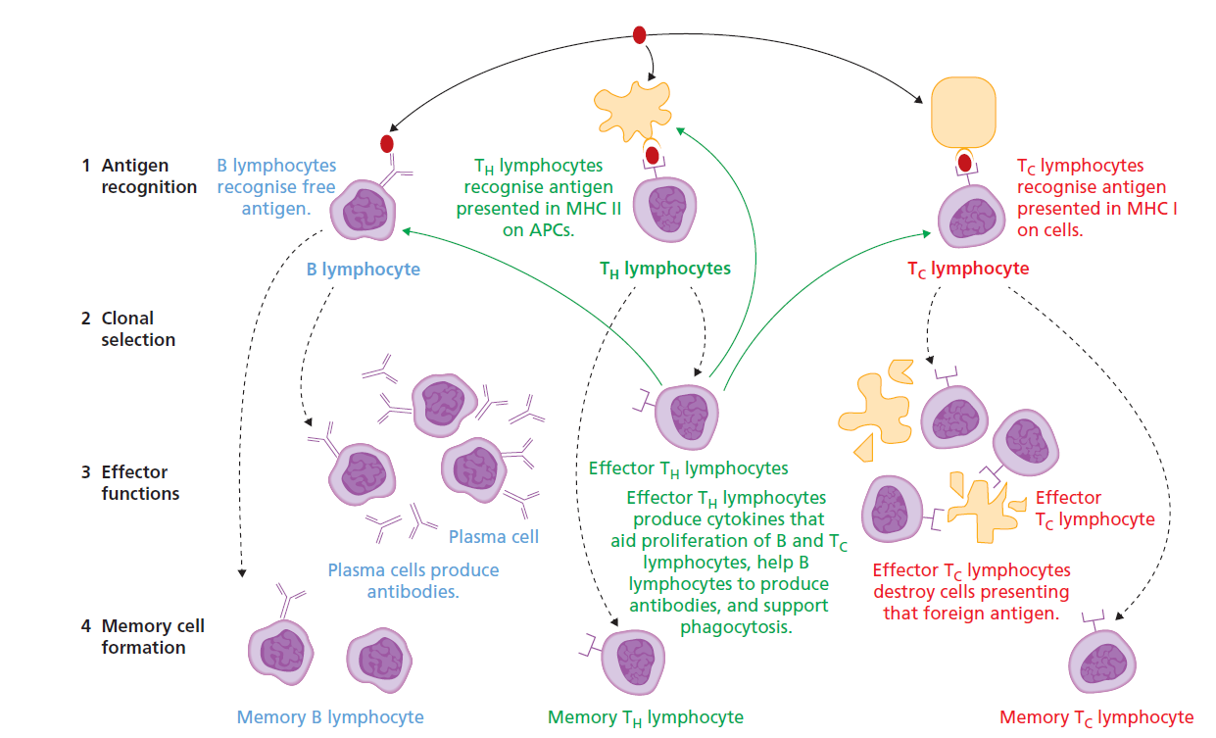
Linking parts of the immune system
FPO
Figure 12.18

Slide 34
Allergy
Immune system malfunctions
The incidence of asthma and hayfever is on the increase in Australia.
These disorders are forms of allergies – exaggerated immune responses to the antigens of normally harmless substances found on pollens, foods, cosmetics, drugs or animals.
These antibodies (usually IgE) bind to mast cells and basophils, triggering release of histamine and other chemicals, causing inflammation. Symptoms include inflammation and excessive mucus production.
Sometimes anaphylactic shock occurs and causes systemic inflammation, constriction of the lung airways and loss of fluid from leaky capillaries into body tissues.

Slide 35
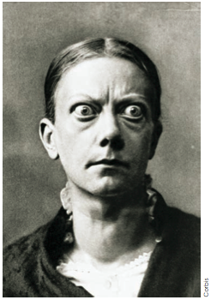
Autoimmunity
Immune system malfunctions
Many mechanisms exist to prevent immune responses directed against self components, but when these fail, autoimmunity develops.
Many different autoimmune diseases exist and can be directed against almost any part of the body, depending on what is the self-antigen (autoantigen).
A striking example is Graves’ disease, in which the autoantigen is the thyroid stimulating hormone (TSH) receptor.
Autoantibodies binding the the TSH receptor mimic the actions of TSH, causing high levels of thyroid hormone production.
Among other symptoms, this causes inflammation around the eyes.
Figure 12.20

Slide 36
Immunodeficiency
Immune system malfunctions
Conditions where a defective immune system renders an individual vulnerable to infection are known as immunodeficiencies.
Immunodeficiencies may be caused be genetic defects (such as SCID) or acquired later in life (such as HIV).
SCID Absence of T and B lymphocytes. The main treatment Severe combined is by bone marrow transplant.
immunodeficiency
HIV HIV targets T_{H} cells, replicates in them and bursts out,
Human destroying the T_{H} cells. The immunodeficiency is
immunodeficiency virus known as Acquired Immunodeficiency Syndrome
(AIDS).

Slide 37
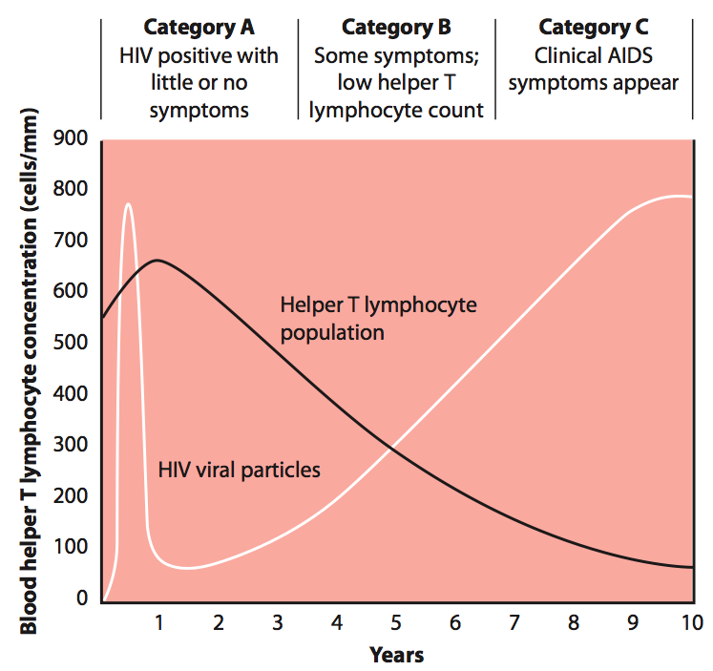
Immunodeficiency
Immune system malfunctions
Early during HIV infection, the immune system is capable of producing a response against the virus.
However, as the T_{H} cell count drops, the viral count increases, and the patient becomes prone to multiple infections that would normally be harmless.
Figure 12.22

